Slide 1
London Calling – Boroughs Analysis
Which boroughs of London have seen the greatest increase in housing prices, on average, over the last two decades?
H
1
Context
4
Constraints within solution space
To discover the more desirable areas (boroughs) to live in based on the ratio of Average Prices in 2018 vs Average Prices in 1998.
- Excel file contains information outside of the 32 boroughs of interest and also has NaN values. The excel file has a greater time span of data than what we will base the results on.
2
Criteria for success
5
Stakeholders to provide key insight
Produce a clear visual that shows which borough had the greatest increase in housing prices.
Interested parties
3
Scope of solution space
6
Key data sources
-Limit the analysis to 2 decades (1998-2018)
-Will only look at the 32 boroughs
-Since data is average prices on a monthly timescale, will use the first month of 1998 and last month of 2018 for analysis
Excel file taken from the government data site that consists of average prices on a monthly period
H
D
E
I
P
Notes:
Hypothesis: Create a Hypothesis with an emphasis on SMART principles. (S – Specific, M – Measurable, A – Achievable, R – Realistic, T – Timebound). If you cannot do this, you do not have a good grasp on the business problem.
Context: With context, we have clearly identified the problem at hand and have elucidated on how our initiative may solve this problem, alongside the commercial implications this will have on the business.
Criteria for Success: Clearly defining the criteria for success ensures that the scope of your work is clearly defined and understood. Otherwise, if this isn’t defined – your work will never end which will result in mismatched expectations.
Scope of Solution Space: Scoping out the solution space ensures that the business initiative is SPECIFIC for a certain segment or area. This prevents solutions that have been developed being scaled and applied for all other business units that the solution may not be responsible or scalable for.
Constraints within Solution Space: Looking forward, what are the foreseeable problems we are likely to encounter? Could this be stakeholder resistance? Could this be we don’t have access to the right data?
Stakeholders to provide key insight: Who are the people I need to speak to, to get the answers I need for my data analysis?
What key data sources are required?
Based off my discussions with the key stakeholders – can we clearly list out all the data sources we need so we can make a highly targeted request as opposed to a scatter-gun approach where we ask for a bit of everything?

Slide 2
Discovery and Process that led to it
Result: The borough of Hackney had the greatest increase in housing prices over the course of two decades from the beginning of 1998 to the end of 2018. Its houses increased by 6.6X their prices, on average.
Process:
Pulled in data from the London DataStore in excel format
Data was transposed so boroughs were in a column and dataframe was reindexed
Dataframe melted to columns of boroughs, code, Month, and Average Prices
DataTypes adjusted and verified before cleaning began
cleaned to remove NaN fields, isolate only the 32 boroughs of interest, and isolate years 1998 to 2018
Initial visualization of the data used a line plot (Month vs Average Prices) with all 32 boroughs overlayed
Function defined to input the melted and cleaned dataframe and output a dataframe with the boroughs as index and columns: 1998 first month prices, 2018 last month prices, and the ratio of 2018 last month prices over the 1998 first month prices. It was sorted in reverse ascension by the ratio.
A bar chart was produced of the boroughs vs the ratio to illustrate the greatest changes graphically.
Challenges Encountered:
Data needed to be expunged of NaN as well as other information that was outside of the 32 boroughs

Slide 3
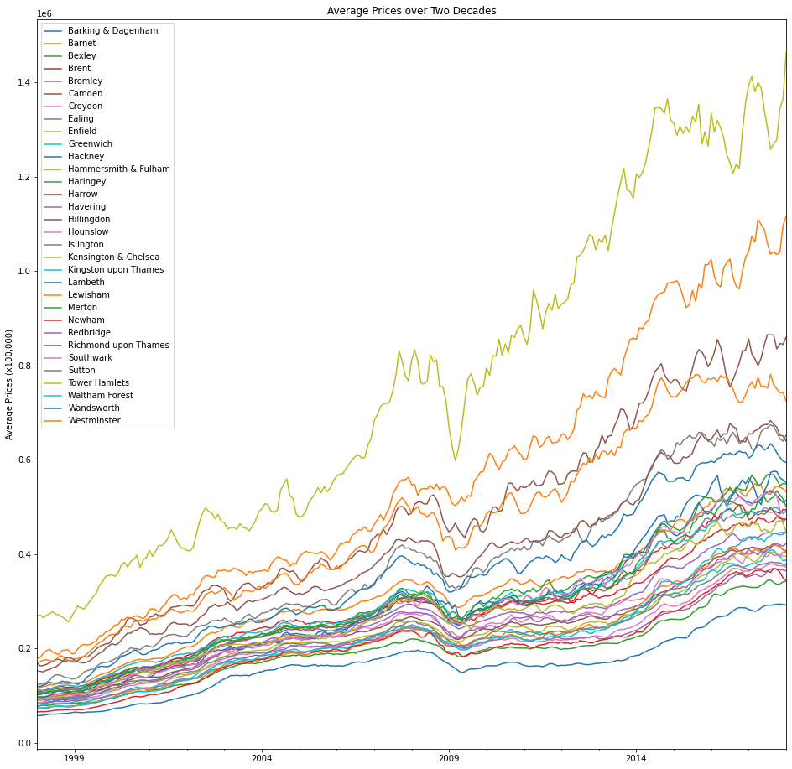
Initial EDA Line Plot
While the initial look at the trend would suggest the largest increase would come from Hammersmith and Fulham, looking at the ratio on the next plot would tell a different story

Slide 4
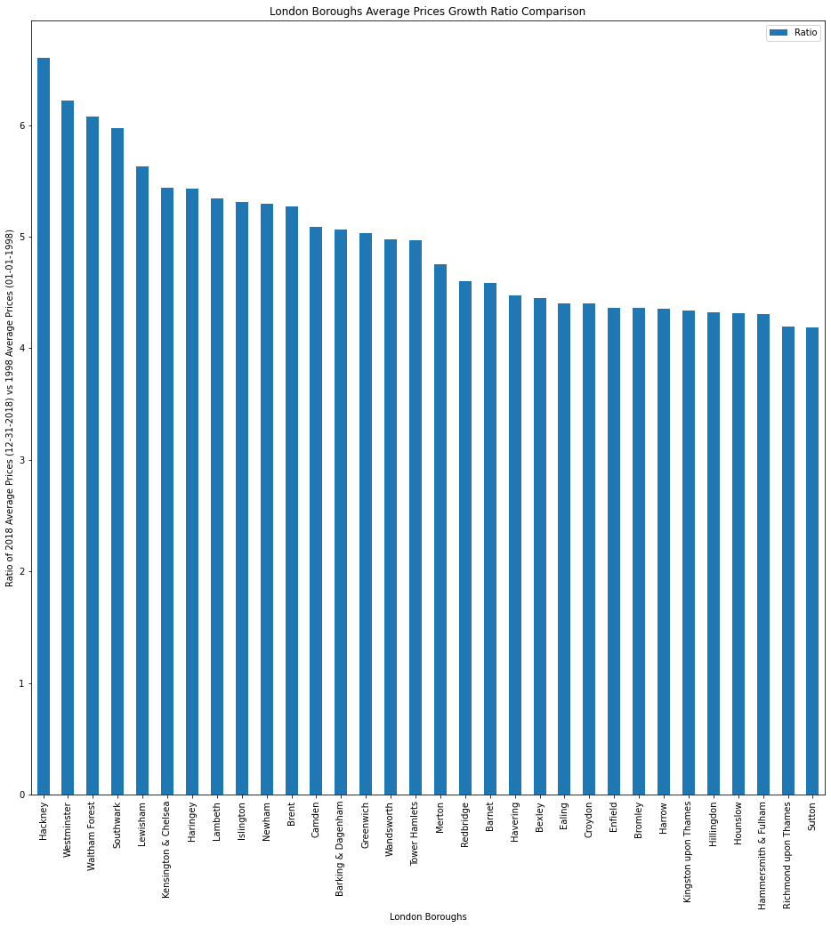
When comparing the ratio of 2018 average prices and 1998 average prices, the borough of Hackney had the largest growth in average house prices and can be considered the most desirable.

